Slide 1


Oracle database
Lecture 42

Slide 2

Today’s Agenda
Cursor For Loop
Parameterized Cursor
Examples

Slide 3
Cursor For Loop
The cursor FOR LOOP statement is an elegant extension of the numeric FOR LOOP statement.
The numeric FOR LOOP executes the body of a loop only once for every integer value in a specified range.
Similarly, the cursor FOR LOOP executes the body of the loop only once for each row returned by the query associated with the cursor.

Slide 4
Cursor For Loop
A nice feature of the cursor FOR LOOP statement is that it allows you to fetch every row from a cursor without manually managing the execution cycle i.e., OPEN, FETCH, and CLOSE.
The cursor FOR LOOP implicitly creates its loop index as a variable with the %rowtype in which the cursor returns and then opens the cursor.
In each loop iteration, the cursor FOR LOOP statement fetches a row from the result set into its loop index. If there is no row to fetch, the cursor FOR LOOP closes the cursor.

Slide 5
Syntax Of Cursor For Loop
The following illustrates the syntax of the cursor FOR LOOP statement:
Syntax:
FOR record IN cursor_name LOOP
process_record_statements;
END LOOP;

Slide 6
Special Point
Note that besides the cursor name, we can use a SELECT statement as shown below:
FOR record IN (select_statement) LOOP process_record_statements;
END LOOP;
In this case, the cursor FOR LOOP declares, opens, fetches from, and closes an implicit cursor.
However, the implicit cursor is internal; therefore, we cannot reference it.

Slide 7
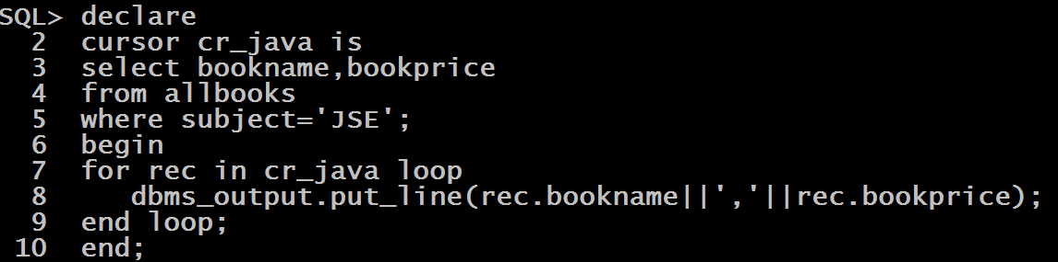
Example
WA PL_SQL script to display bookname and subject of all the books belonging to JSE.

Slide 8
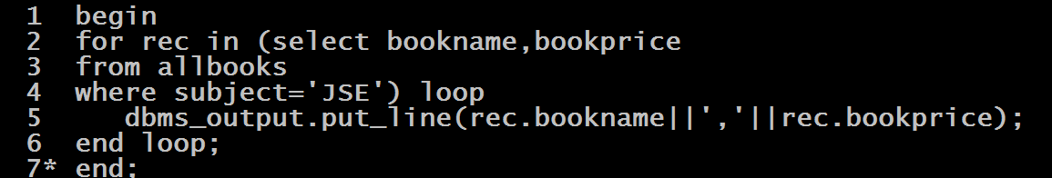
Example
Rewrite the previous code directly using the SELECT statement in FOR

Slide 9
Parameterized Cursor
An explicit cursor may accept a list of parameters.
Each time we open the cursor, we can pass different arguments to the cursor, which results in different result sets.
Syntax:
CURSOR cursor_name (parameter_list) IS
cursor_query;

Slide 10
Example
WA PL-SQL script to accept a subject name from the user and display the bookname and bookprice of all the books of that subject. In case no books of the subject is found then display the message No Books Found

Slide 11
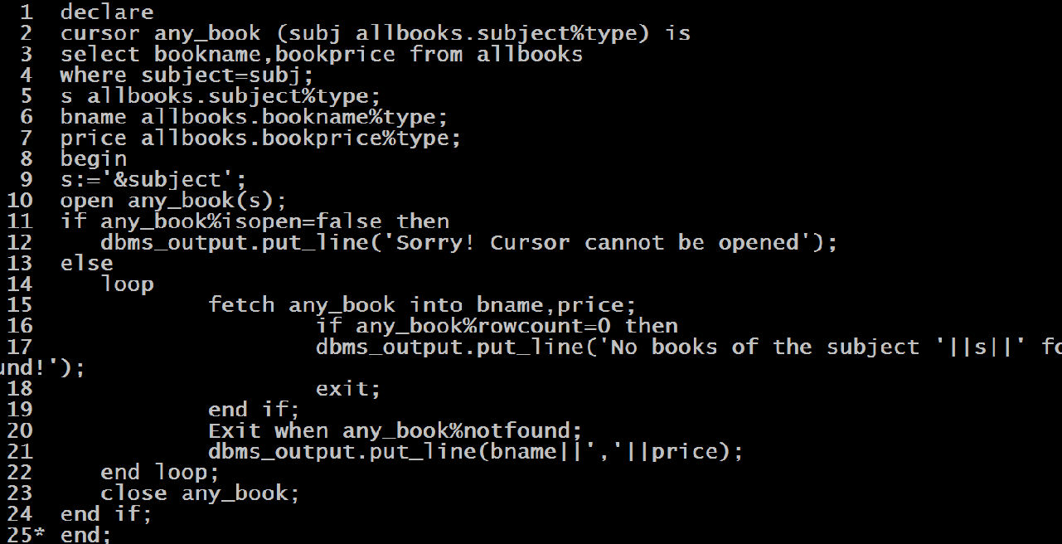
Example

